Slide 1
GTU - COMPUTER ENGINEERING STUDENT CLUBS MANAGEMENT SOFTWARE
CSE 496 SECOND PRESENTATION
Muhammed OĞUZ
Süleyman GÖLBOL
Project Supervisors:
Research Assoc. Evren Çifçi
Assoc. Prof. Mehmet Göktürk
May 2023

Slide 2
Contents
Project Schema and Description
Link and QR Code
Overall UI - Client
Swagger - Server
Diagrams
Repository Folder Structure
Timeline
Success Criteria
References

Slide 3

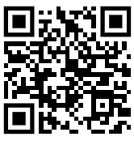
Link and QR Code
Our site link:
https://ogrenciprojeleri.gtu.edu.tr/KulupYonetim

Slide 4
Project Schema and Description
https://ogrenciprojeleri.gtu.edu.tr/KulupYonetim
The student clubs management system app offers three login options: member, club admin, and SKS (full admin). Members can join clubs and communicate with others, while club admins have additional privileges, such as managing events and approving new members. SKS users have full control over the app. Overall, the app provides a streamlined solution for student organizations to manage their operations and engage with members effectively.

Slide 5
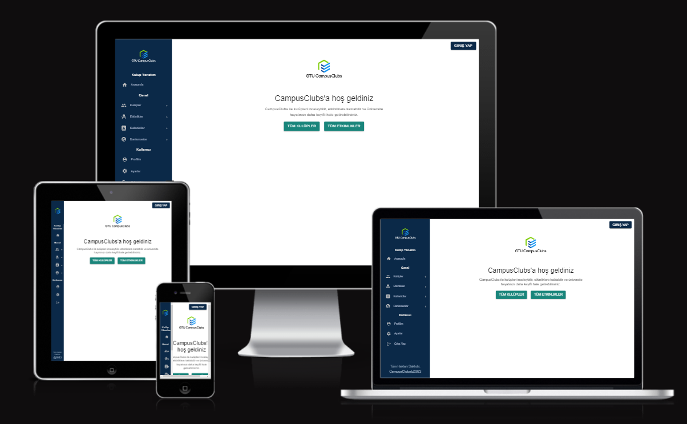
Overall UI - Home Page

Slide 6
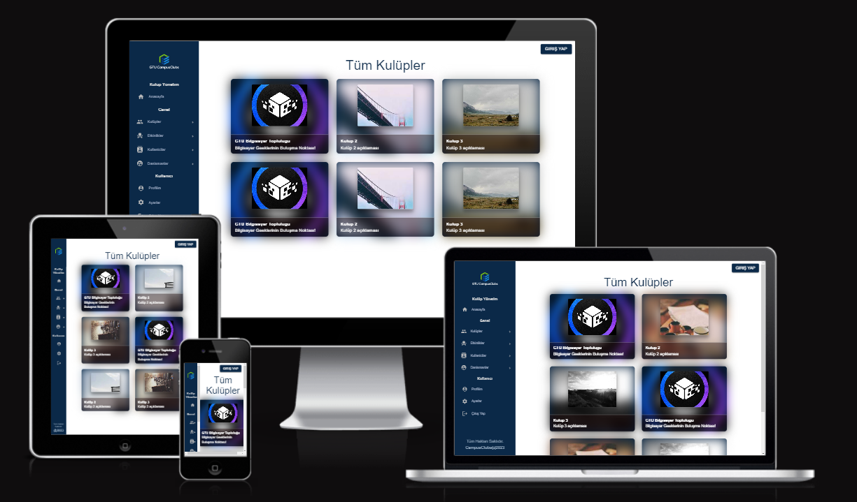
Overall UI - Clubs

Slide 7
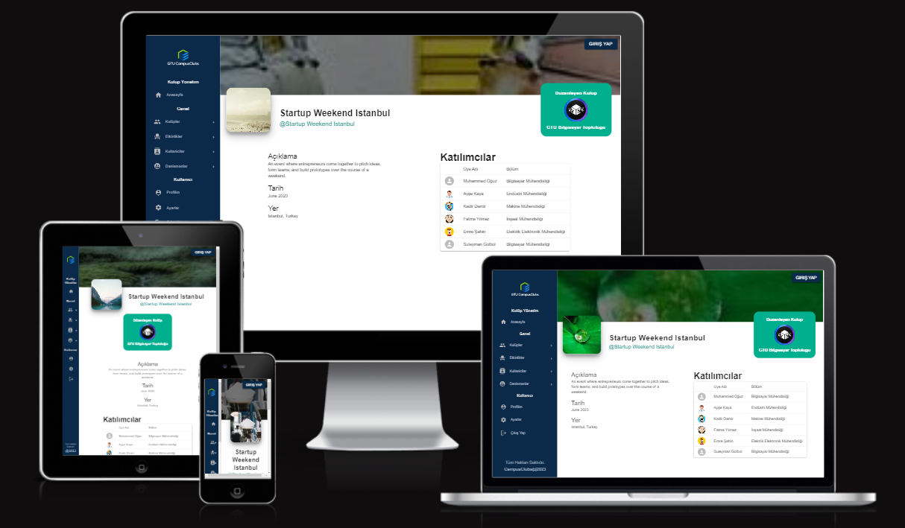
Overall UI - Home Page

Slide 8
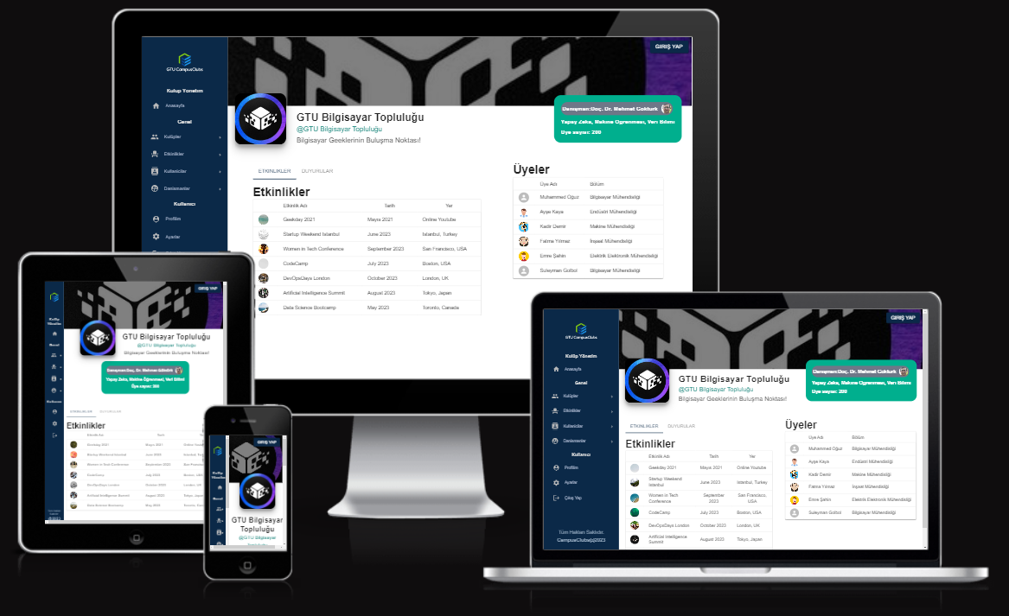
Overall UI - Club Profile

Slide 9
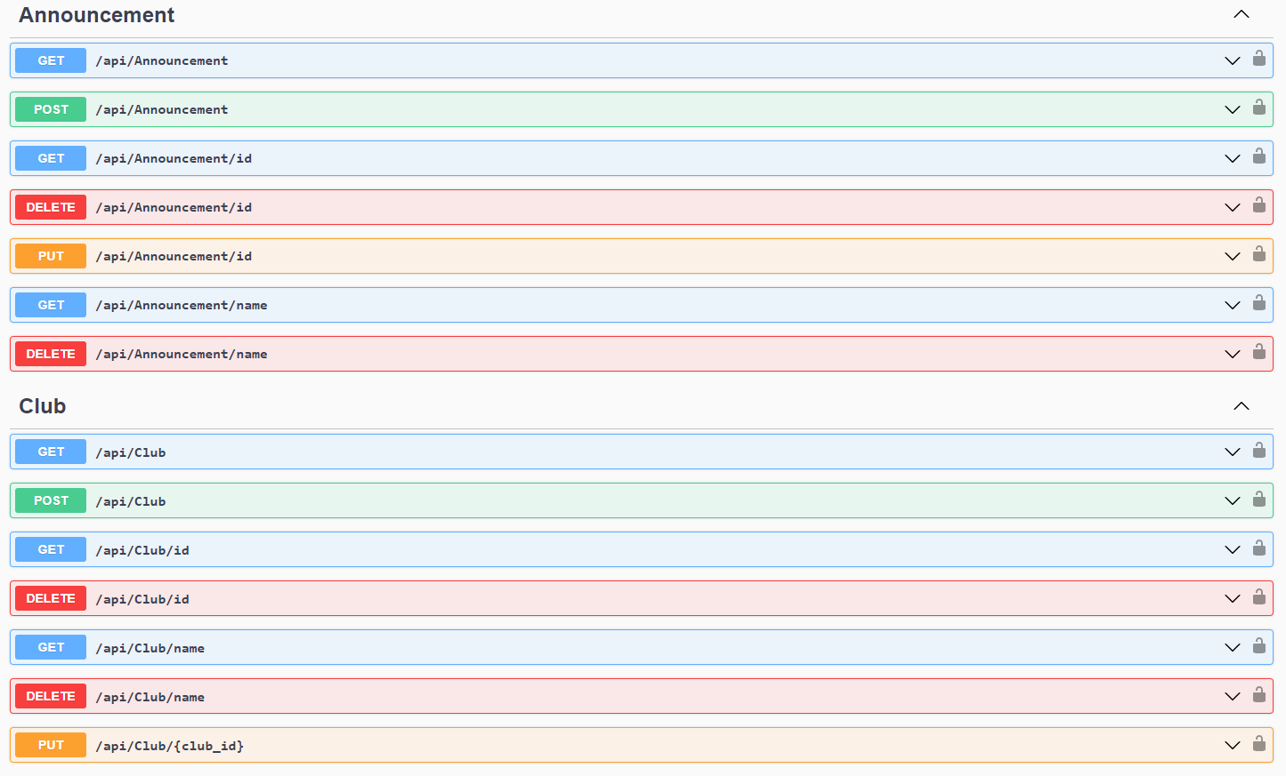
Server Side Apis - Swagger
Notes:
Rest Services

Slide 10
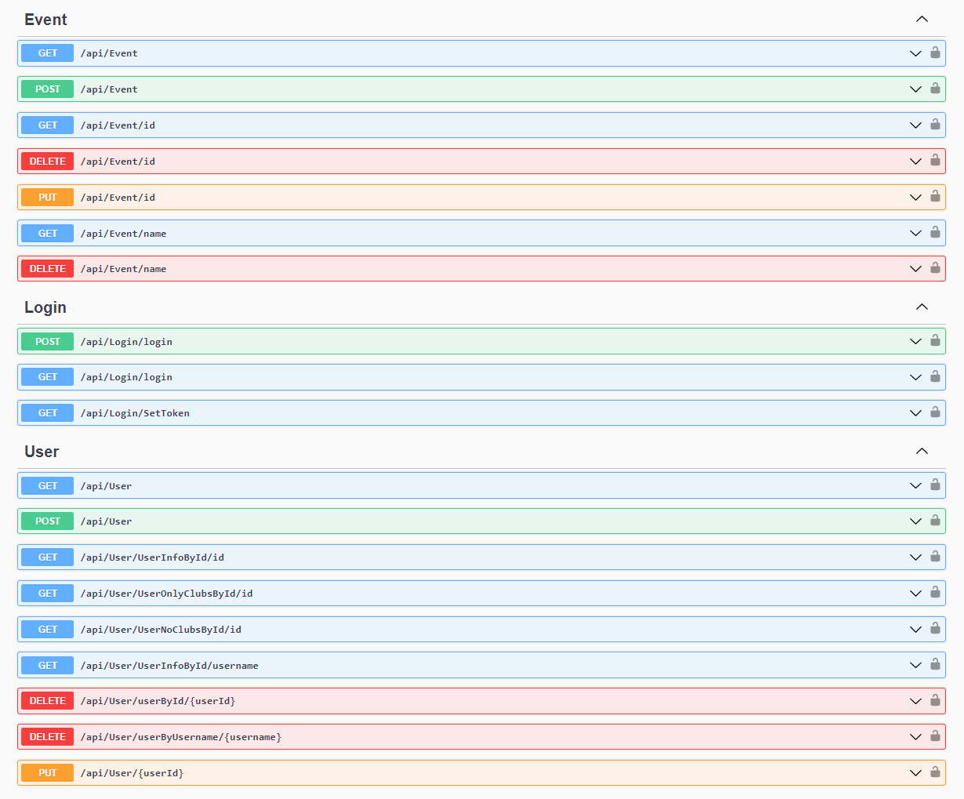
Server Side Apis - Swagger

Slide 11
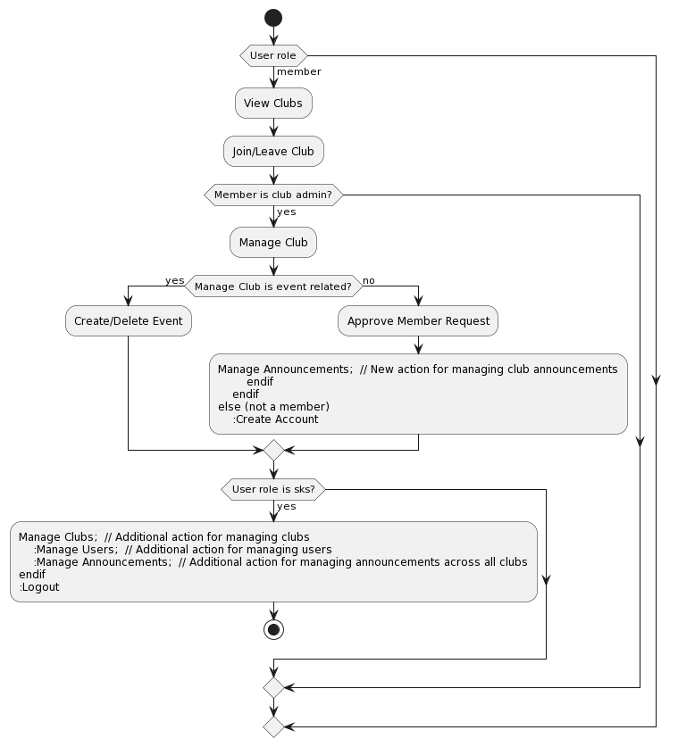
Activity Diagram

Slide 12
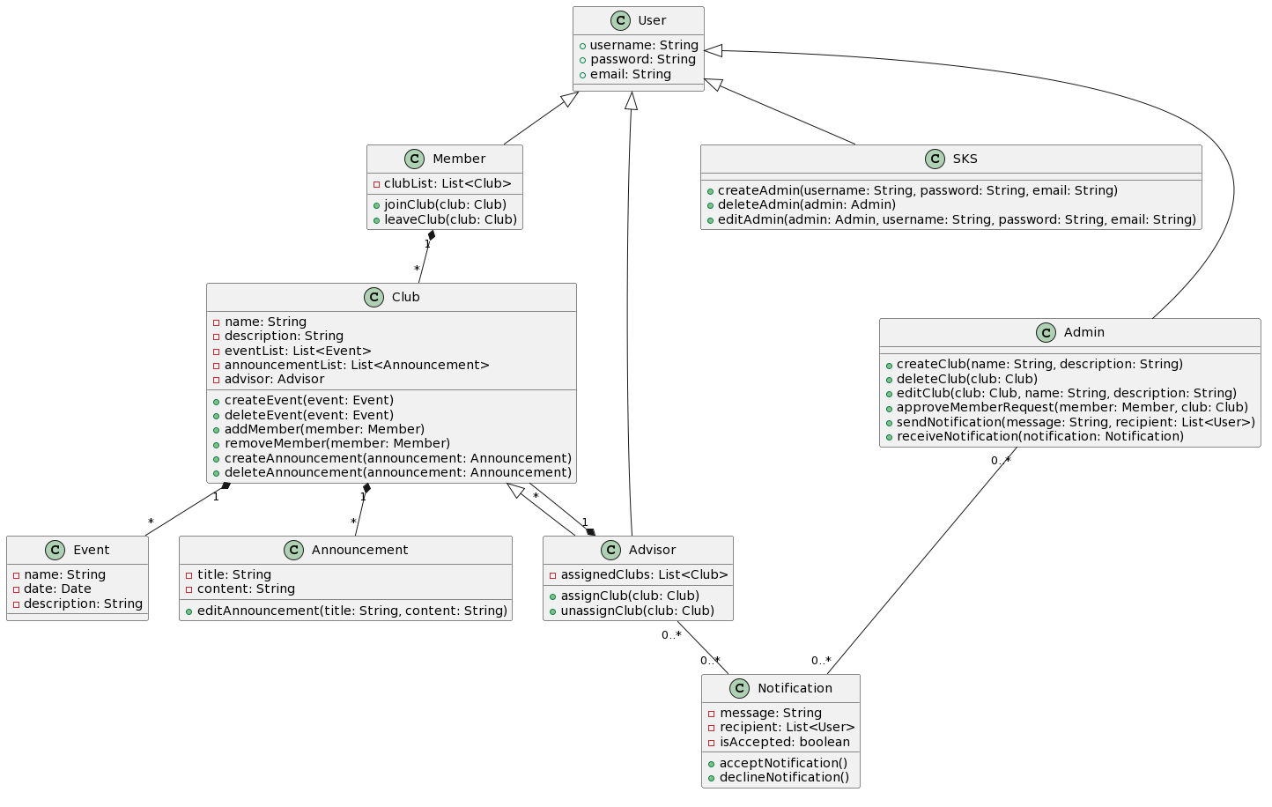
UML Diagram

Slide 13
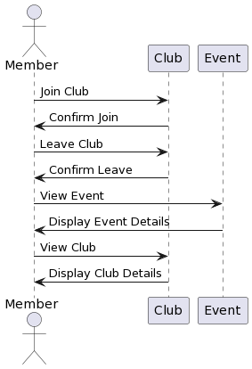
Member Use Case Diagram

Slide 14
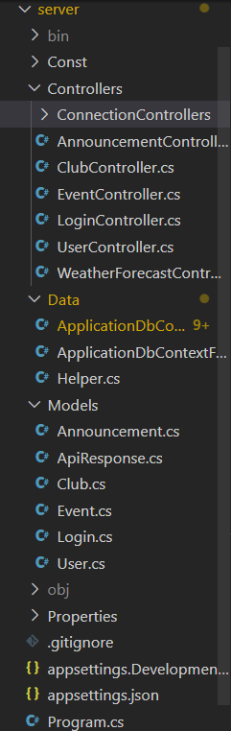
Repository - Server

Slide 15
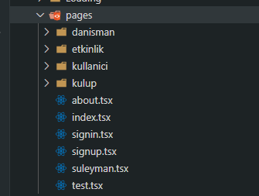
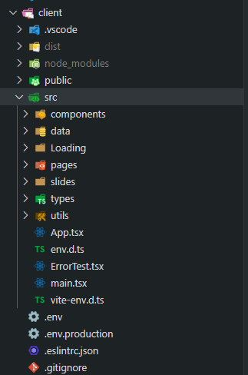
Repository - Client
Pages

Slide 16
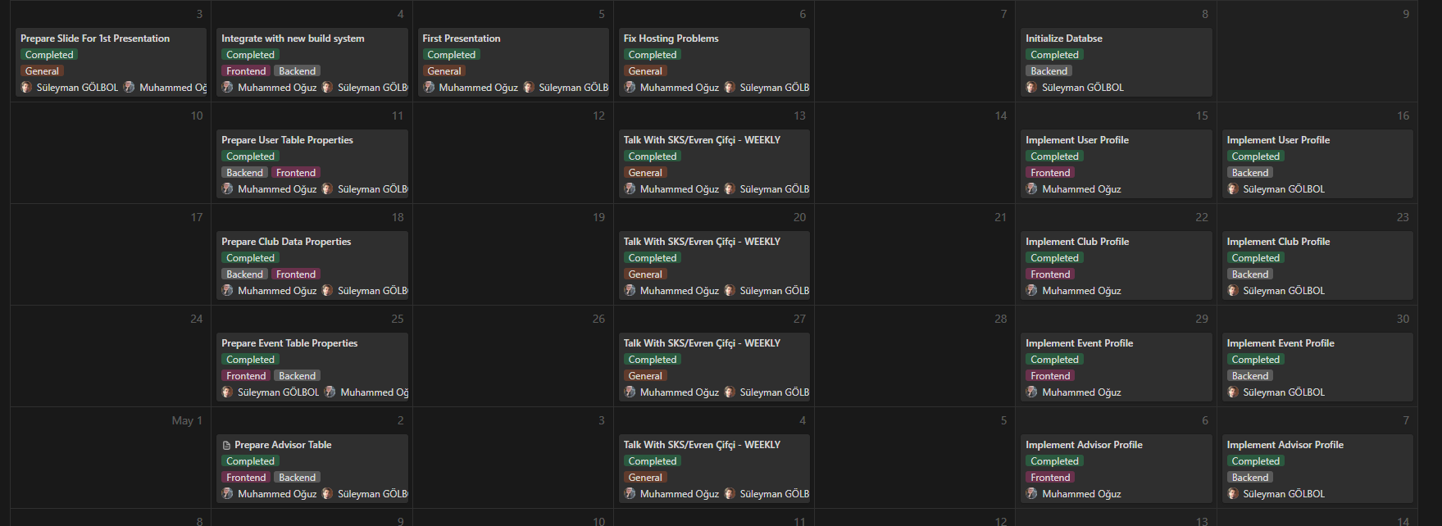
Timeline (Completed)

Slide 17
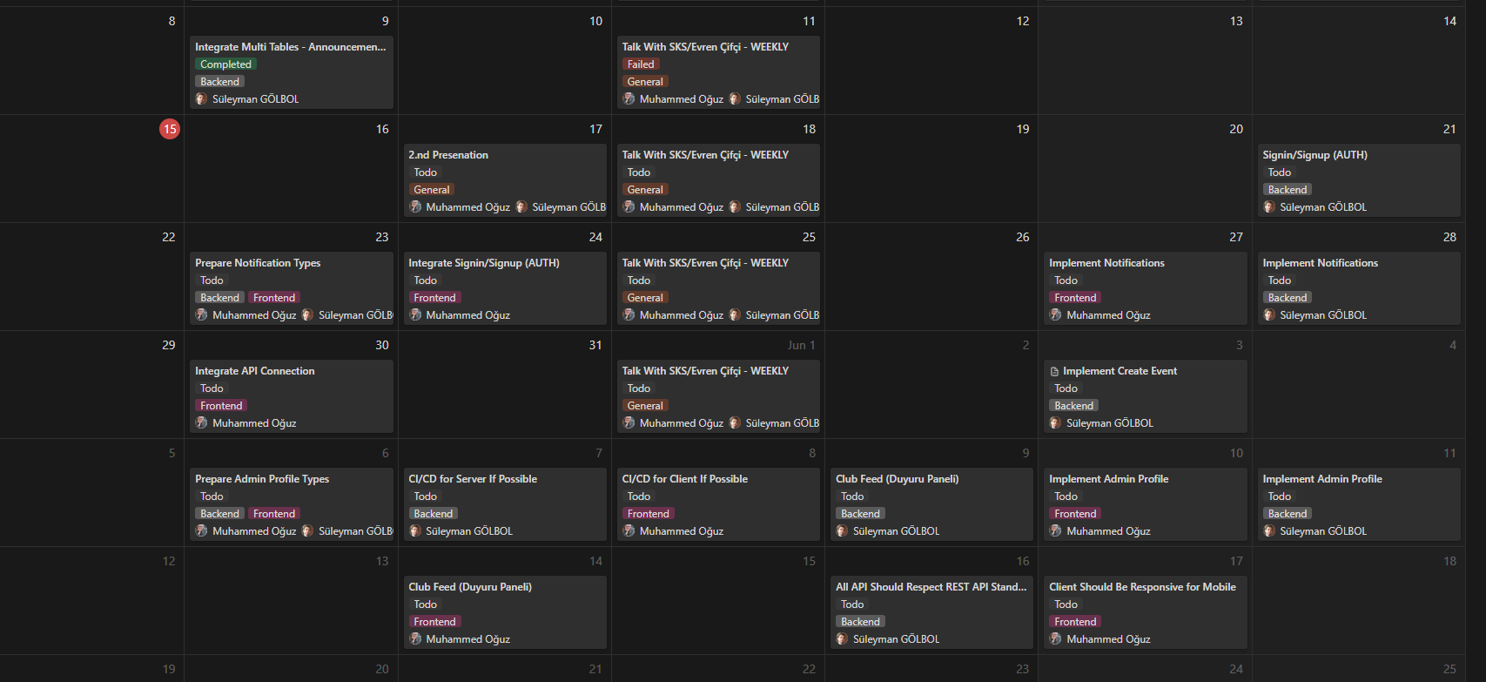
Timeline (Planned)

Slide 18
Timeline
1st Meeting (Preliminary Presentation) | April 05, 2023, Wednesday
2nd Meeting | May 17, 2023, Wednesday
Report Submission | June 18, 2023, Sunday
Trailer Submission | June 18, 2023, Sunday
3rd Meeting (Final Presentation) | June 21, 2023, Wednesday
Demo | June 22, 2023, Thursday

Slide 19
Success Criteria
1. The system should integrate with other systems or services as needed, such as Outh2 portal for login authentication.
2. Response should be made at most 30 milliseconds.
3. The system should be responsive for mobile and desktop devices.
4. APIs should be proper for REST.
5. Project should be deployed on the school site.

Slide 20
References
https://dotnet.microsoft.com/en-us/
https://react.dev/
https://nodejs.org/en
GTU BIM / SKS (Evren Çifci)

